Slide 1
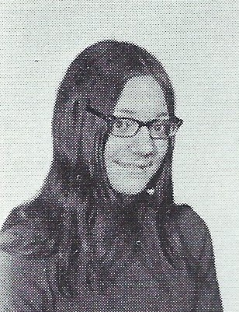
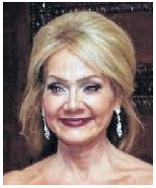
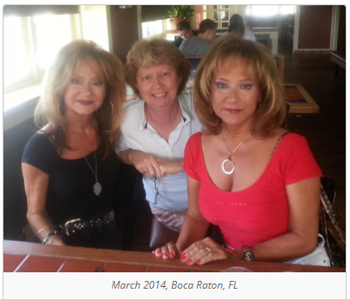
Mary Thomas (Creamer) 4/19/2019
9th Grade

Slide 2
Mary Thomas (Creamer)
GUILDERLAND Mary C. Thomas Creamer, 65 of Guilderland, passed away peacefully on Good Friday, April 19, 2019, with her family by her side in the Hospice Inn at St. Peter's Hospital. Mary was born in Albany, an identical twin and one of three triplets born to the late George E. Thomas and Mary J. Promiscuo Thomas. She lived in Albany as a child but lived in Guilderland most of her life. She was a graduate of Guilderland High School and was employed for many years by the Albany County Office of the Public Defender in the Police Court Division. Mary cared deeply about her family. She had a great devotion to the Blessed Mother, and prayed the Rosary often, always including the intentions of others in her prayers. Mary is survived by her husband Michael J. Creamer, Sr.; her children, Michael J. Creamer, Jr. (Melissa) of Knox, Tracy Vanderwarker (Anthony) of Rotterdam, and William Creamer (Teresa) of Guilderland; her siblings Diana d'Anna (Sebastian) of Naples, Fla., her identical twin Christina "Tina" Hunter (Ralph) of Murrells Inlet, S.C., and fellow triplet Christopher J. Thomas (Mary Bouck) of Guilderland and Jeffrey N. Thomas of Knox; her grandchildren, Hayley, Kyla, and Leila Creamer, and Isabella and Madison Vanderwarker; and by many nieces and nephews. Mary was predeceased by her brother George A. Thomas; and her sisters-in-law, George's wife Kimberly Helm Thomas and Christopher's wife Susan Milkins Thomas. Funeral services will be held in the Hans Funeral Home, 1088 Western Ave., Albany, Wednesday morning at 8:15 a.m., and from there to Mary's funeral Mass and celebration of her life at All Saints Catholic Church, 16 Homestead St., Albany (behind CVS), at 9 a.m. Relatives and friends are invited to attend, and may call at the funeral home Tuesday from 4-7 p.m. Entombment will be in St. Agnes Cemetery, Menands. The family suggests memorial contributions to The Community Hospice, St. Peter's Hospital Foundation, 310 S Manning Blvd, Albany, NY 12208. To leave a message of condolence for the family or obtain directions to the funeral home, please visit www.HansFuneralHome.com.

