Slide 1
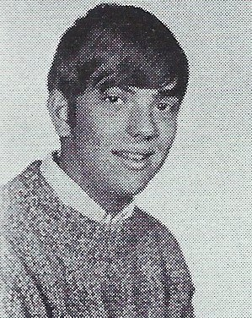
David Patrick Taylor 11/12/2018
9th Grade

