Slide 1
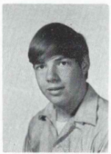
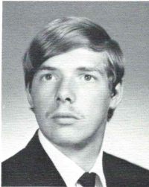
Steven Szalkowski 3/24/2003
9th Grade
12th Grade
ALBANY Steven P. Szalkowski, 48, of Saratoga Springs, died Monday, March 24, 2003 at Saratoga Hospital. Mr. Szalkowski was born in Albany, and lived here most of his life until moving to Saratoga Springs ten years ago. He was a graduate of Guilderland High School, and studied for a time at SUNY. He was employed for many years as a self employed handyman, and later was employed by the Finch-Pruyn Paper Co. in Glens Falls. He also was an avid hunter and fisherman. Mr. Szalkowski was predeceased by his father John P. Szalkowski. He is survived by his mother Virginia Szalkowski of Albany, his fiance Sharon Cross of Saratoga Springs; his brothers Michael Szalkowski of Albany, John Szalkowski of East Greenbush, Mark Szalkowski of Treasure Island, FL, and Vincent Szalkowski of Albany; and by his nephews Ryan and Tyler Szalkowski. A Mass of Christian Burial will be celebrated in the Church of the Holy Cross, Western Ave. & Rosemont St., Albany, Thursday morning at 9:30 a.m. Relatives and friends are invited. There will be no calling hours. Interment will be in St. Agnes Cemetery, Menands.

