Slide 1
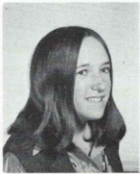
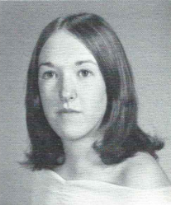
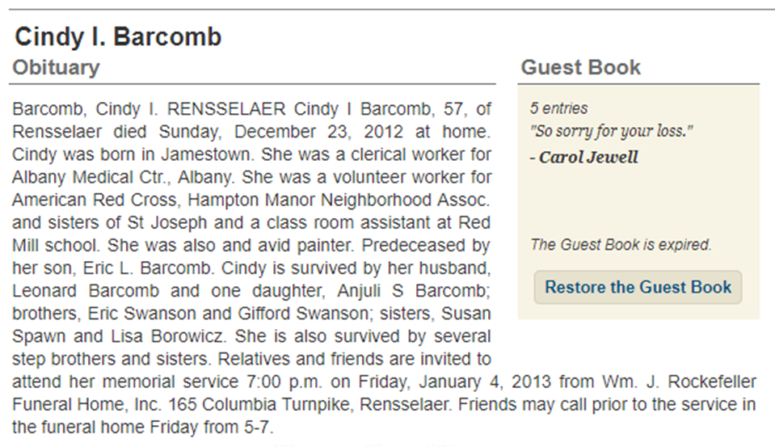
Cindy Swanson (Barcomb) 12/23/2012
9th Grade
12th Grade

Slide 2
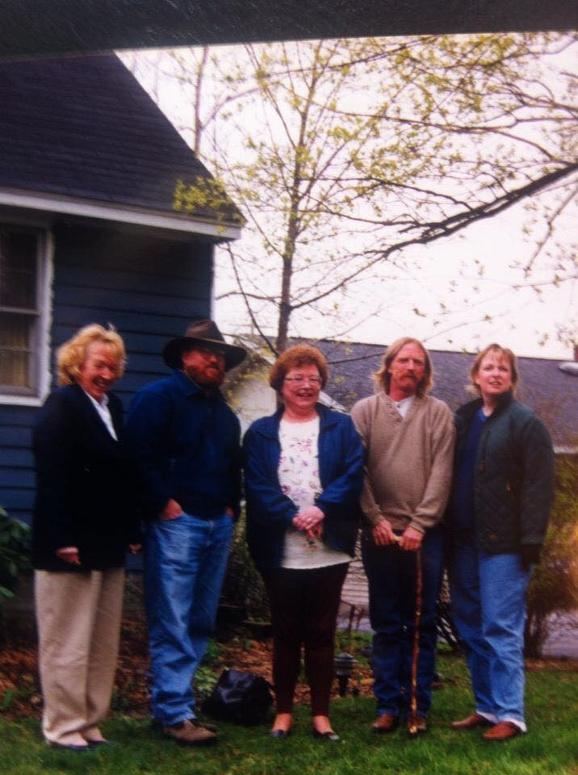
Cindy Swanson
Cindy on far left

