Slide 1
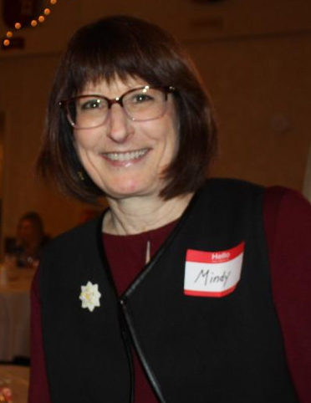
Mindy Jean Soule 7/28/1955 – 4/5/2021
12th Grade
At 40 year reunion

Slide 2
