Slide 1
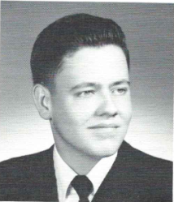
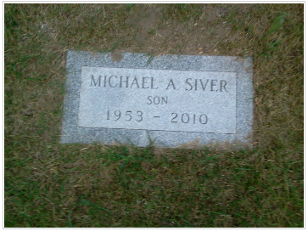
Michael Siver 12/27/2010
12th Grade
Siver, Michael A. VOORHEESVILLE Michael A. Siver, 57, of South Main St. died Wednesday, December 27, 2010. Born in Albany, Michael was the son of the late Thomas and Myrtle Valentine Siver. He worked for 37 years for the New York State Department of Health, retiring in 2009. Michael was a New York Yankee fan and enjoyed watching local stock car racing, especially at the Fonda Speedway. Also, he was an avid history and civil war buff. Survivors include his siblings, Thomas V. Siver (Catherine) of Voorheesville, Richard O. Siver of Niskayuna, Kathi Driessen (Rick) of Rotterdam and Nicholas Siver (Marcia) of Guilderland and several nieces and nephews. Friends are invited to visit with Michael's family on Tuesday, January 4, 2011 from 4-7 p.m. at the Reilly & Son Funeral Home, Voorheesville. Graveside services will be held at the Prospect Hill Cemetery in Guilderland at 10:00 a.m., Wednesday, January 5, 2011. For those who wish, contributions in memory of Mike may be made to SEFCU, Attn: Pet Connection, 700 Patroon Creek Blvd., Albany, NY 12206. reillyandsonfuneralhome.com

