Slide 1
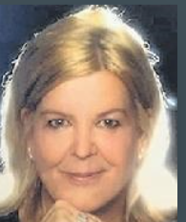
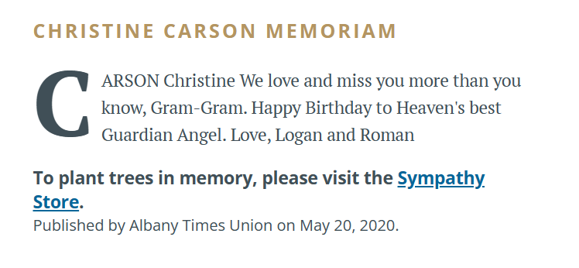
Christine Satterlee (Carson) 3/15/2020
9th Grade

