Slide 1
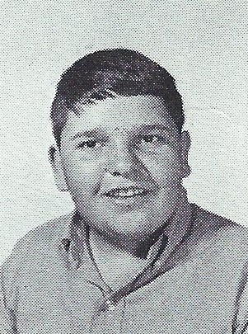
David Robusto 5/9/2019
9th Grade

