Slide 1
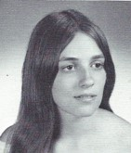
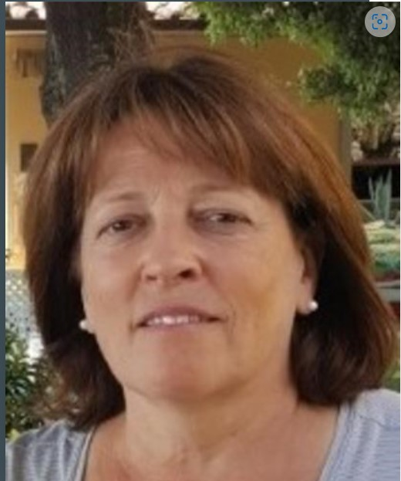
Debra Randall 5/4/1955 - 1/9/2023
12th Grade
WILLIAMSTOWN Mass. - We are devastated to announce that Debra A. Randall, 67, passed away on January 9, 2023, after a courageous fight against an aggressive cancer. She was in the loving presence of her family until the end.
Deb was born in Albany on May 4, 1955 to John W. Randall and Avis Gibbs. Her early years were spent hiking in the woods, building dams, climbing trees, sledding, skiing, cycling (and working as a bike mechanic at Down Tube!), and otherwise enjoying nature and the great outdoors. She graduated from Guilderland Central H.S. in 1973, from SUNY Albany in 1977 with A B.A. in Anthropology, and from RPI with a master's degree in Archeology and Geology. She moved to the Boston area where her first career was working for Harvard in its industrial archeology program as a leader of several "digs." She then devoted many years to raising her three children in

Slide 2
Hingham, Mass. After her children were grown, she obtained her teaching licensure (and another master's degree), and moved to Quincy, Mass where she taught Earth Science at The Woodward School for girls, and later at Quincy High School.
After retirement, she and her partner, Peter, moved to Easley, South Carolina. Finally, the pandemic and the birth of grandchildren brought them back to Williamstown where they built a beautiful life in their home with a view of Mount Greylock and the surrounding Berkshires. They enjoyed daily coffee on their deck where they fed the many bird species on the railings and watched the varied wildlife that ambled across their property. Deb so loved and respected the Earth and nature.
Deb was intelligent, loving, unerringly supportive, insightful and kind, adventurous and funny. You will not find a more giving, caring person than Deb. She impacted everyone she met, always putting others before herself. She could often be found reading her Science journals and insisted she was a "nerd," which she was not. One of Deb's passions was driving her manual shift sports car when traveling about. You could find Deb, almost daily, tending to her many beautiful gardens and landscape projects or building walking paths throughout her property for her grandchildren to enjoy. Deb looked forward to and so enjoyed the many trips that they took, especially the one to Europe where so many fond memories were made. We will miss her beyond measure!
She leaves behind to grieve: the love of her life, Peter Umbrianna; her beloved children, Evan LaPann, Robert LaPann (Bessybel), and Emily LaPann (Luis Aceves); her grandchildren, Ismael, Rajaa, and Eva Lee LaPann and Joaquin Aceves; her sister, Cheryl Randall (Bill Carpenter); dear step-children, Jenna, Rachael, Peter and Anthony Umbrianna; a step-grandchild, Akoura; her father-in-law, sisters-in-law, brothers-in-law and several cousins.

Slide 3
Calling hours will be held at the Hans Funeral Home, 1088 Western Av. Albany, Saturday afternoon from 3-6 p.m. Relatives and friends are invited to call. Interment will be at Graceland Cemetery, 680 Delaware Ave. Albany, NY 12209 on Sunday at 11 a.m.
In lieu of flowers, donations may be made to: Center for Great Apes in Wauchula Florida. https://centerforgreatapes.org/donate/ or the National Audubon Society https://act.audubon.org/a/memorial-gift To leave a message of condolence for the family or obtain directions to the funeral home, please visit www.HansFuneralHome.com

