Slide 1
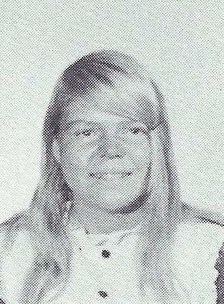
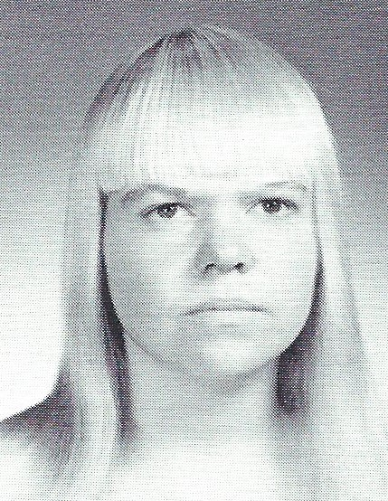
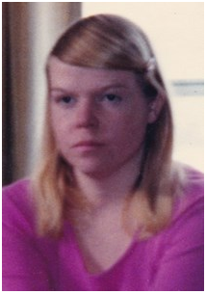
Mary Lou Quay (Sapio) 7/3/2019
9th Grade
12th Grade

Slide 2
Mary Lou Quay (Sapio)
GUILDERLAND CENTER - Mary Lou Quay Sapio, 64, passed away on July 3, 2019 at her home, after a short illness. Mary Lou was the daughter of the late William Quay, Sr. and Rachel Helligas Quay. She was a graduate of GCHS and her work career spanned over 35 years at the Guilderland Center Nursing Home in the laundry department which is now called The Grand Rehabilitation and Nursing at Guilderland. She was honored this winter by The Grand by her friends and work colleagues for her long service. Mary Lou is survived by her son, Richard A. Kronsberg; her grandson, Randy A. Kronsberg; her granddaughter, Rachel A. Kronsberg; her sisters, Jane (Richard) Willey and Virginia (Paul) Tymchyn; and her brothers, William (Bonnie) Quay, Jr. and John Quay. She is also survived by many nieces, nephews, and cousins. Mary Lou was fond of all animals and those who wish may donate in her memory to the Guilderland Animal Shelter, P.O. Box 339, 5209 Western Turnpike, Guilderland, NY 12084 or to the family to help with medical expenses. As was her desire, there will be no viewing or services.

