Slide 1
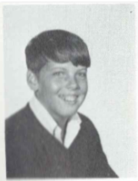
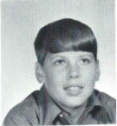
Jeff Pitcher 2/13/1991
9th Grade
10th Grade
Jeffrey R. Pitcher, 35, of Van Vranken Avenue died Wednesday in Prince George's County, Md., after injuries sustained by being hit by a motor vehicle on a highway there.
Born in Albany, he lived in Guilderland for many years, moving to Duanesburg, where he lived for 12 years, then to Schenectady.
He was a graduate of Guilderland Central High School.
For many years he owned and operated Jeff's Lawn Service before an illness forced him to retire.
He was a member of the Princetown Reformed Church.
Survivors include his mother, Ada Jean Pitcher of Schenectady; four sisters, Joan Lawrence and Wendy Pitcher, both of Schenectady, Ann Marie Baker of Clifton Park and Linda Jesse of Madisonville, Ky.; and his maternal grandmother, Cordelia Ponson of Schenectady.
Calling hours will be from 10-11 a.m. Saturday in the Fredendall Funeral Home, 199 Main St., Altamont, with a graveside service to follow in St. John's Lutheran Cemetery, Colonie.

