Slide 1
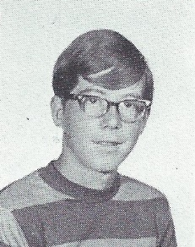
Bob Pelton 1/2/1955 – 1/1/2019
9th Grade

