Slide 1
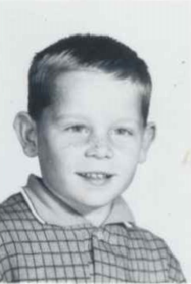
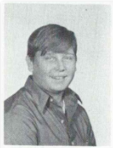
David Orsini 12/21/1954 – 2/19/2008
1st Grade
9th Grade
Orsini, David E. ALTAMONT David E. Orsini, 53, died Tuesday, February 19, 2008 at Hospice Inn at St. Peter's Hospital. He is the beloved son of Edward D. and Betty Orsini; the brother of Kathleen Lambing of Calif. and Linda Beloncik of Rotterdam; uncle of Brianne and James Nyahay of Rotterdam, Dina Furnari and Joe Vause of Colonie, Jennifer and Holly Lambing of Calif.; grand uncle of Jimmy Nyahay; cousin and nephew of many; and a friend to everyone who has ever met him. David loved camping and his Harley Davidson. A funeral service will be held Sunday at 1 p.m. at the Fredendall Funeral Home, Altamont. Calling hours will be prior to the service from 9 a.m. to 1 p.m. Burial is in Fairview Cemetery, Altamont. In lieu of flowers donations may be made to Community Hospice, 445 New Karner Rd., Albany, NY 12205.

Slide 2
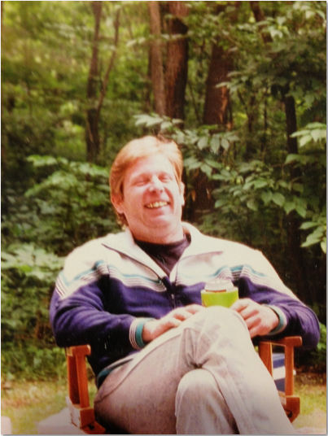
David Orsini

