Slide 1
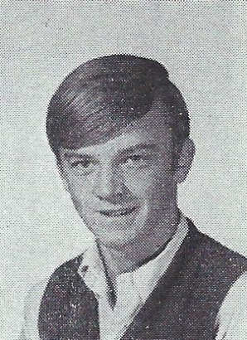
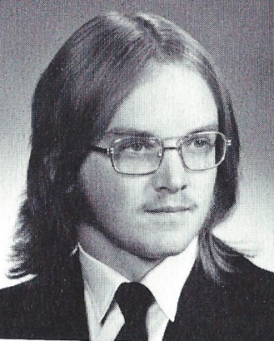
Tom Noonan 10/1/2015
9th Grade
12th Grade

