Slide 1
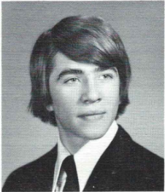
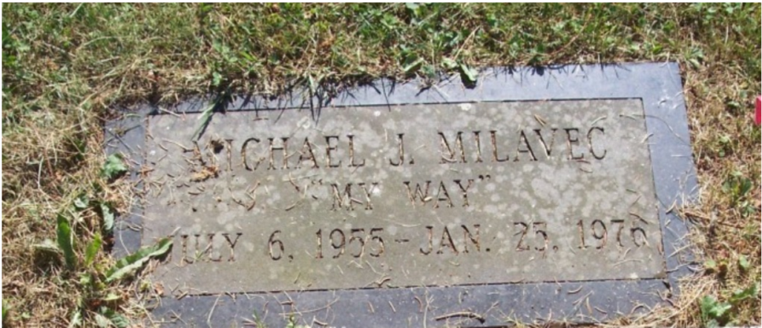
Michael Milavec 7/6/1955 – 1/25/1976
Youth Dies of Pneumonia at MVCC
A former Mohawk Valley Community College student was found dead at 11:15am yesterday in a dormitory room according to Utica police. The youth was Michael J. Milavec, 20, of 705 Leober Road, Schenectady. Police said Dr. Charles Brady, Oneida County coroner attributed death to pneumonia. He said death occurred at about 4am.
Milavec had been visiting the campus for the college’s winter weekend festivities according to Dean of Students Affairs Lewis White. White said Milavec had completed his college studies at the end of the fall semester. Police responded to an inhalator call about 10:30 in Dormitory 4.
12th Grade

