Slide 1
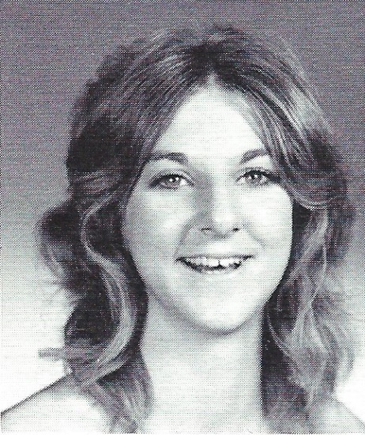
Maryanne Mendel (Slauson) 9/19/2010
12th Grade

Slide 2
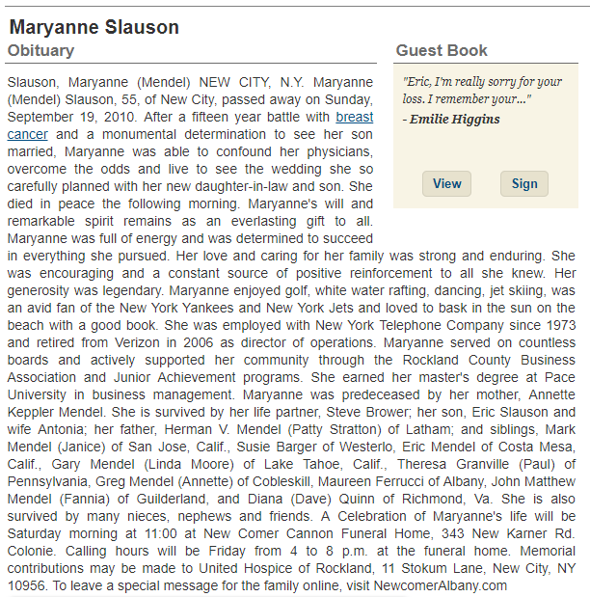
Maryanne Mendel

