Slide 1
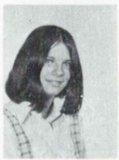
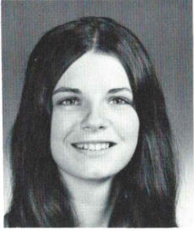
Donna McGurn (Weinman) 1/25/2006
9th Grade
12th Grade
LEE, Mass. Donna J. Weinman, 51, of Lee, passed away on Wednesday, January 25, 2006 at her home after a brief illness. Born in Albany, she was the beloved daughter of the late Henry and Helen Regan McGurn. Donna was a resident of Albany for most of her life before moving to Massachusetts seven years ago. She was a 1972 graduate of Guilderland High School and worked for many years at the New York State Board of Elections. She was an avid New York Yankees fan and enjoyed golfing. Donna is the cherished sister of Thomas (Debbie) McGurn of Slingerlands, Linda (Matt) Kobieski of Ariz., William (Linda) McGurn of Clifton Park and the late Richard, James and Karen McGurn. She is the devoted aunt of Danielle, Michelle, Matthew, Meaghan and Kelsey. Also surviving is her beloved friend, Mario Gallacchi of Delmar. Donna's family would like to thank the staff of Laurel Lakes, especially Delores, Erka, Barbara, Shari, Jamie, Luia, Brian, Ron, Christina, Martha and Sarah for all of the care and support they gave Donna during her stay at Laurel Lakes. A Mass of Christian Burial will be celebrated Saturday morning at 9:00 in St. Margaret Mary's Church, Homestead St., Albany. Relatives and friends are invited and may call at the Hans Funeral Home, 1088 Western Ave., Albany Friday evening from 4-8. Interment will be in St. Agnes Cemetery, Menands.

