Slide 1
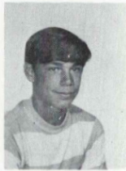
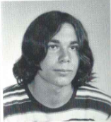
John Leonard 6/10/2006
9th Grade
11th Grade
SARATOGA SPRINGS John P. Leonard, 50, of Saratoga, died peacefully on Saturday, June 10, 2006, after a short illness. John was born in Albany and raised in Guilderland and graduated from Guilderland High School in 1973. He attended Sullivan County Community College and received a degree in communications from Schenectady County Community College. John moved to Saratoga in 1993 where he was employed as the director of marketing of the Racing Department for Saratoga Gaming and Racing. John was an accomplished videographer with many successful productions to his credit. He also held the volunteer position of treasurer of the Saratoga Harness Hall of Fame. John was a passionate fan of the New York Football Giants, the New York Yankees, music and of course, the ponies. John was predeceased by his parents, Robert J. Leonard Jr. and Kathryn A. Leonard; his brother, Robert J. Leonard III. He was a devoted husband to Jeanne O'Brien Leonard; also survived by two children, John P.L. Leonard (L.J.) and Janelle M. Leonard; loving brother of Janis Leonard, James Leonard, Ellen Dorato of Guilderland and Peter Leonard of Las Vegas, Nev.; brother-in-law of Deborah Leonard, Michael Dorato, Pattie McArdle, Michael O'Brien and John O'Brien; proud uncle of Bobby, Jay, Mikey, Shelley, Kelsey, Nikki, Kelly, Erin, Megan, Shannon, Will and Brittany; also survived by several aunts, uncles, cousins and many friends. Calling hours will be held Wednesday from 4 to 8 p.m. at the DeMarco-Stone Funeral Home, 5216 Western Turnpike, Guilderland. The parish family of Christ the King Church will gather at 4:30 for a service of prayer and remembrance. All are welcome. Funeral services will be begin Thursday at 8 a.m. from the funeral home followed at 9 a.m. by a Mass of Christian Burial at Christ the King Church. Interment, Prospect Hill Cemetery, Guilderland.

