Slide 1
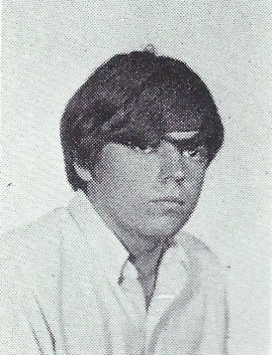
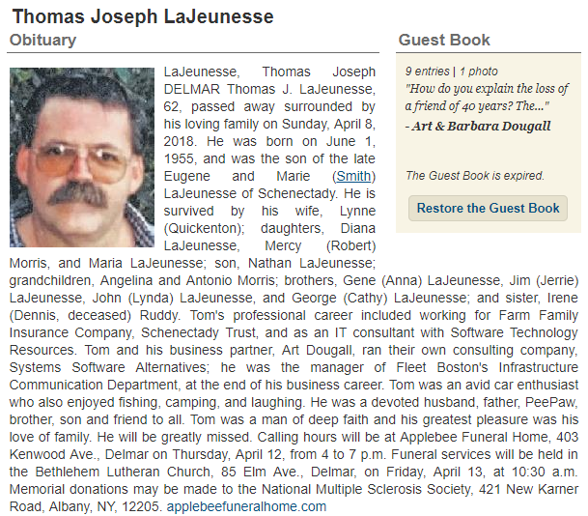
Tom LaJeunesse 4/8/2018
9th Grade

