Slide 1
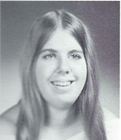
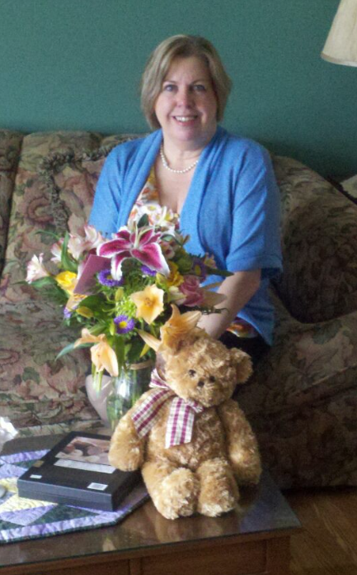
Kathy Fischer (Crofts) 10/2/2021
12th Grade
Survived by children Kevin and Grace.
Pre deceased by husband Curtis.

Slide 2
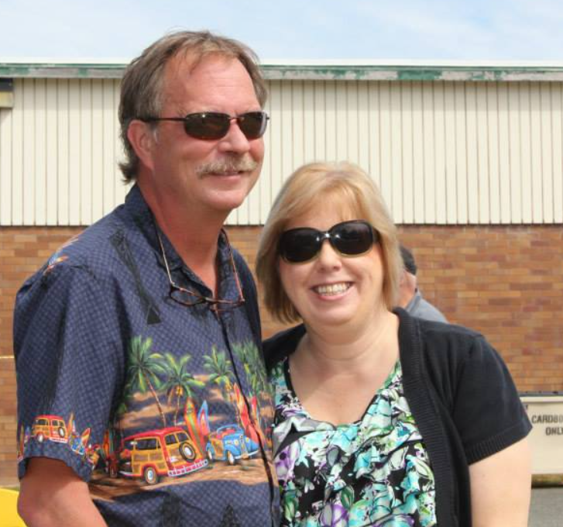
Kathy Fischer Crofts

