Slide 1
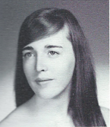
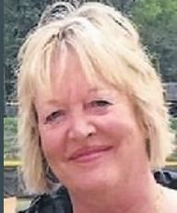
Judy Farley (Hagyard) 6/4/1955 – 3/4/2019
12th Grade

Slide 2
Judy Farley (Hagyard) 6/4/1955 – 3/4/2019
Haggard, Judith Farley FEURA BUSH Judith Farley Hagyard, 63, passed away on Monday, March 4, 2019, surrounded by the love of her family. Judy was born in Albany to the late Philip and Anne Farley on June 4, 1955. In 1989, Judy married the love of her life, Bert J. Hagyard. They were married for 14 years until his passing in 2004. Her nursing career began at age 14 when she volunteered as a Candy Striper at St. Peter's Hospital. For the past 32 years, she worked as an L.P.N. for Albany Obstetrics & Gynecology, Albany. Judy will forever be remembered for her spunk and sass which everyone who knew her could attest to. She loved trips to the casino, camping in Lake George, Friday nights at Meads and Sunday dinners at Lisa’s.
Judy was predeceased by her beloved husband, Bert Hagyard; and her brother, Brion Farley. She is survived by her sister, Patty (Mike) Wroblewski; her nieces, Erica Wroblewski, and Anna Farley; her nephews, Dane Wroblewski, and Jack Farley; and her furry friend, "Louie."
Calling hours will be held at New Comer Cremations & Funerals, 181 Troy Schenectady Road, Watervliet on Friday, March 8, from 4-7 p.m. A funeral service will be held in the funeral home on Saturday, March 9, at 10 a.m. Burial will be held in the Holy Sepulchre Cemetery, Rensselaer. In lieu of flowers and donations, we ask that you take a moment and hug your loved ones or walk in the sunshine for a moment, an hour or a day. Time waits for no one.

