Slide 1
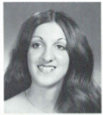
Marlen Ann Falcone (Lipina) 5/9/1955 – 9/9/1996
9th Grade
12th Grade
NISKAYUNA -- Marlen Ann Lipina, 41, of Niskayuna, died September 9, 1996. She moved from Syracuse to this area in 1965. Graduated from Guilderland High in 1975 and Central Bible College in Springfield, MO. She worked as a Medical Transcriptionist in the Radiology Dept. of Albany Medical Center for 16 years. In recent years Marlen expressed God's creativity and her joyous faith in the Lord Jesus Christ through her painting. Her watercolors of flowers have been exhibited throughout the Capital District and are in private collections. Articles about her work have appeared in the Schenectady Gazette and the Fall 1995 issue of Country Living Gardener. She is survived by her husband of 8 years, Michael Lipina; her parents, Mr. and Mrs. Leo J. Falcone, Sr.; four brothers, Victor, Anthony, Leo J. Jr. and Gerald Falcone; also by several sisters-in-law, nieces and nephews. A service will be held Wednesday 10 am at the Loudonville Community Church, 374 Loudon Rd. Interment Memory's Garden. Calling hours will be held Tuesday from 6 to 9 pm at Guilderland's DeMarco-Stone Funeral Home, 5216 Western Turnpike (Rt. 20). Contributions may be made in Marlen's memory to the charity of one's choice.

Slide 2
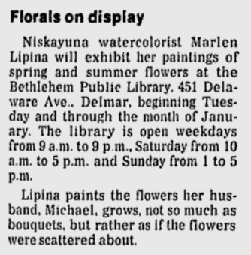
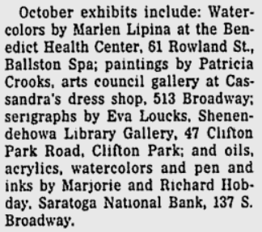
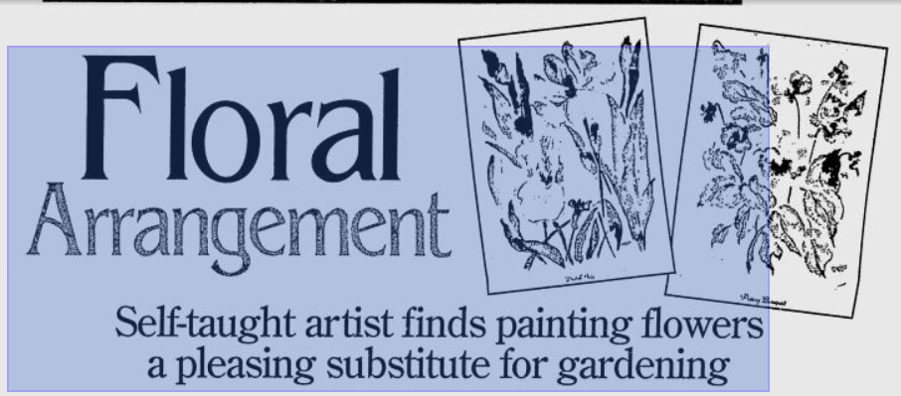
Marlen Ann Falcone (Lipina)
Schenectady Gazette 12/29/94
Schenectady Gazette 9/25/95
Schenectady Gazette 1/4/96

Slide 3
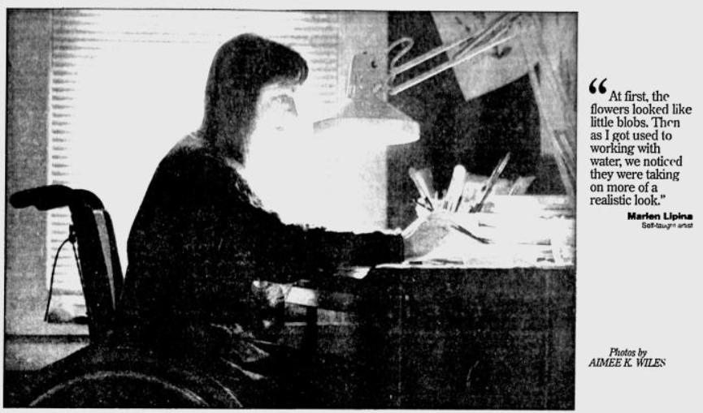
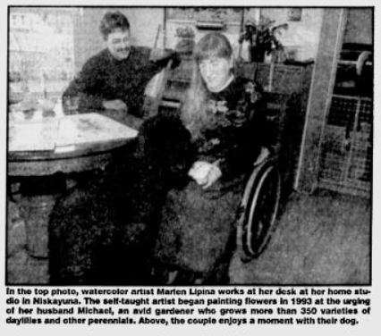
Marlen Ann Falcone (Lipina)

Slide 4
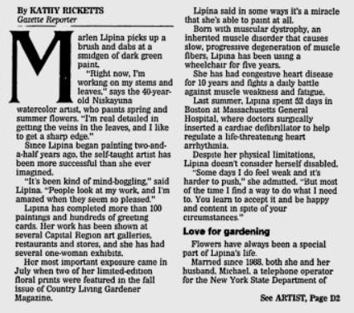
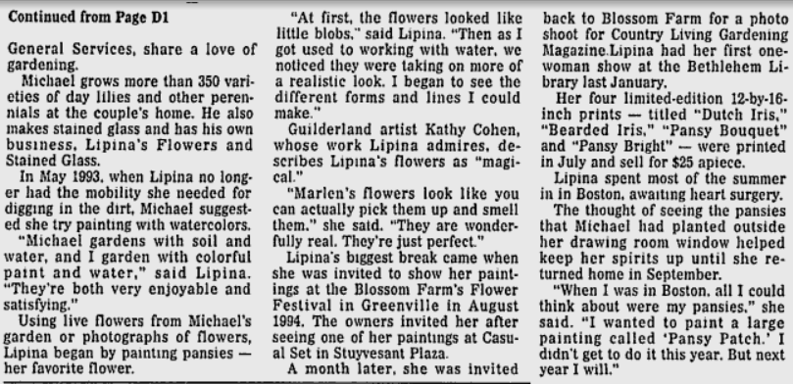
Marlen Ann Falcone (Lipina)

Slide 5
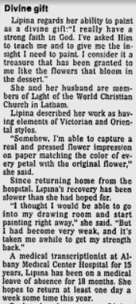
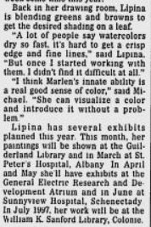
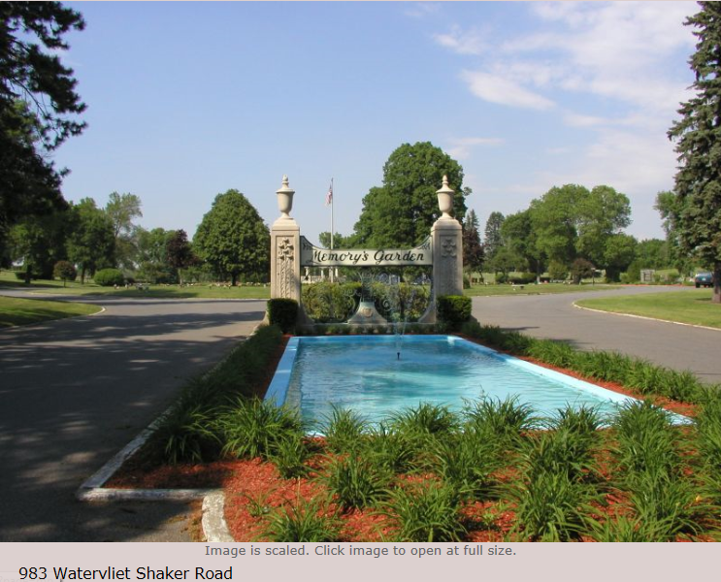
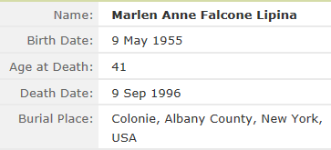
Marlen Ann Falcone (Lipina)

