Slide 1
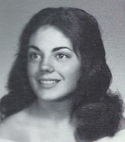
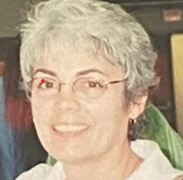
Debra DuGuay (Bamberger) 7/27/1955 - 4/27/2022
12th Grade
Voorheesville - Debra DuGuay Bamberger, 66, passed away peacefully on Wednesday, April 27th, 2022, at St. Peter’s Hospital after a long battle with cancer. Debra was born in Albany to the late Edward and Gail (Donnelly) DuGuay.
She was a graduate of Guilderland High School (1973) and SUNY Buffalo (1977). She worked as an occupational therapist at St. Peter's Hospital and for BOCES. Debra was a life-long pet owner, avid quilter and crafter, and loved to travel both domestically and abroad.
She is survived by her son Daniel Paoletti and wife Laura of Brooklyn, NY; siblings Edward (Shari) DuGuay of Guilderland and Cindy (David) Kahlbaugh of Delmar. She is also survived by an uncle, Kirk Donnelly of East Greenbush, four nephews and their families, and many cousins.

Slide 2
She enjoyed many laughs and adventures with a close-knit group of high school friends who were always by her side, especially as she battled her cancer.
In lieu of flowers, donations made be made to the ASPCA.
Relatives and friends are invited to visit Debra’s family on Sunday, May 1, 2022 from 4:00 to 6:00 pm at McVeigh Funeral Home, 208 North Allen Street, Albany, NY 12206. Please enter the funeral home from the rear parking lot entrance only.
Funeral services Monday, May 2, 2022 at 10:00 am at St Francis of Assisi Parish (Delaware Ave Site) 391 Delaware Ave, Albany, NY 12209 where her Funeral Mass will be celebrated.
The Rite of Committal will immediately follow the Mass at St. Agnes Cemetery, Menands.
To leave Debra’s family a message on their guestbook, obtain directions, or view other helpful services, please visit www.mcveighfuneralhome.com.

