Slide 1
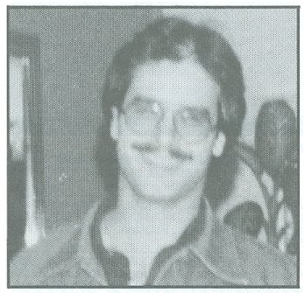
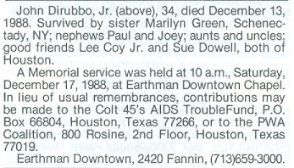
John DiRubbo 12/13/1988
9th Grade
11th Grade

