Slide 1
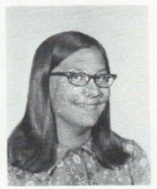
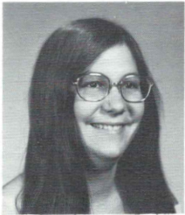
Catherine Dansereau (Patten) 5/7/2006
9th Grade
GUILDERLAND Catherine Ann Dansereau Patten, 50, of Guilderland, passed away on Sunday, May 7, 2006 at Albany Memorial Hospital after a short illness. She was born in Savannah, Ga. and had been a Guilderland resident for most of her life. Cathy had worked as Director of Disaster Services for the American Red Cross and with the NY State Health Department. She was a realtor for over 20 years, most recently with Caldwell Banker in Albany. Cathy was a member of the Greater Capital Association of Realtors. She was a volunteer with Susan G. Komen Foundation Race for the Cure and Whiskers Animal Benevolent League. Cathy was an assistant at the Arts Center of the Capital Region. She enjoyed gardening, pottery, reading, history and her cats. She is survived by her parents, Raymond and Theresa Dansereau of Loudonville; her cherished daughter, Sarah E. Patten; sister of Michael (Barbara) Dansereau
12th Grade
of E. Berne, Robert (Colleen) Dansereau of Tipp City, Ohio, Nancy Dansereau of Clifton Park, Mary (Mark) Molander of Cary, N.C. and John Dansereau of Albany; loving aunt of Matthew, Michael, Max and Lucas; also survived by several aunts, uncles and cousins. Interment will be in St. Agnes Cemetery, Menands. In lieu of flowers and at the request of the family, memorial contributions are suggested to the Susan G. Komen Breast Cancer Foundation, PO Box 13535, Albany, NY 12212 or to the charity of your choice, in memory of Catherine A. Patten.

