Slide 1
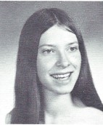
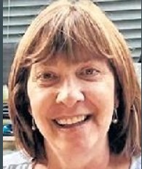
Kathy Daguillo (Ackert) 7/29/1955 – 10/10/2021
12th Grade

Slide 2
Kathy Daguillo (Ackert) 7/29/1955 – 10/10/2021
Ackert, Kathleen GUILDERLAND Kathleen Ackert, 66 years of age, passed away on Sunday, October 10, 2021, at home in Guilderland, surrounded by her loving husband and children.
Born in Albany on July 29, 1955, to Elizabeth (Butlin) Daguillo and the late Samuel Daguillo, she was one of six children and graduated from Guilderland High school.
Kathleen was a loving wife, mother and grandmother; she was happiest surrounded by her family. She decided to go back to school, at the age of 45, to become a medical assistant as her passion was helping others and she retired from the Endocrine Group in 2019 to spend more time with her grandchildren. Kathleen loved to garden, watch her grandchildren play sports and go to the ocean with her family. Anywhere her family was, is where she wanted to be.
Kathleen is survived by her loving husband of 50 years, Norris Ackert; children, Hope (David) Hardwick, Heather (Todd) Harrigan, and Norris (Raquel) Ackert III; grandchildren, Samantha and Brianna Hardwick, Aiden and Cooper Harrigan, Kyler, Ryan and Brielle Ackert; siblings, Karen (Joe) Vivenzio, and Pauline (Natalie) Zolner; predeceased siblings, Samuel Daguillo, Christine (Kenneth) Sagendorf, and Gerald (Cheryl) Daguillo; and several nieces and nephews.
Calling hours will be held on Monday, October 18, from 4-7 p.m. at New Comer Cremations & Funerals 343 New Karner Rd, Colonie. A funeral service will be held on Tuesday, October 19, at 10 a.m. in the funeral home. Interment will follow in Memory Gardens Cemetery. Memorials are suggested to St. Jude Children's Research Hospital. For more information, please see NewComerAlbany.com.

