Slide 1
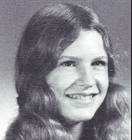
Susan Carman Luyet 5/24/2024
12th Grade
In May 2024 Susie lost her battle with cancer. She spent decades windsurfing on her long board paddling around off the coast of Specklesville on Maui. She certainly was a mermaid from Altamont. She also enjoyed making jewelry when she was on the island. She married Francois (Luyet) in the late 80s. They built a chalet in Switzerland where he was from and devoted much time there prior to her beloved golden retrievers growing old thus impacting her off island travel.
She lived a simple life cherishing close friendships and was most interested in the arts, reading, windsurfing and her doggies. As for hometown once out of high school she never looked back. Susie is survived by her brother Bruce and sister Candy.

Slide 2
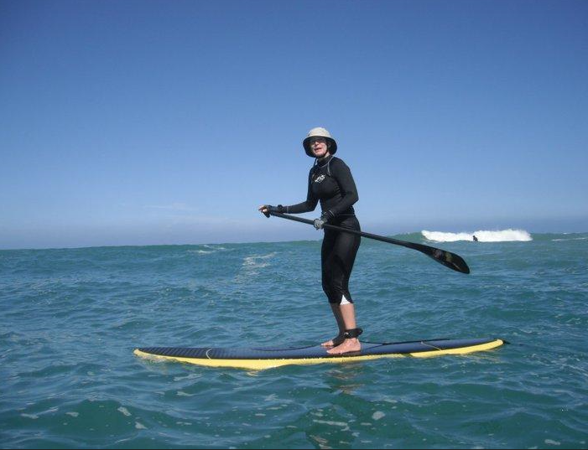
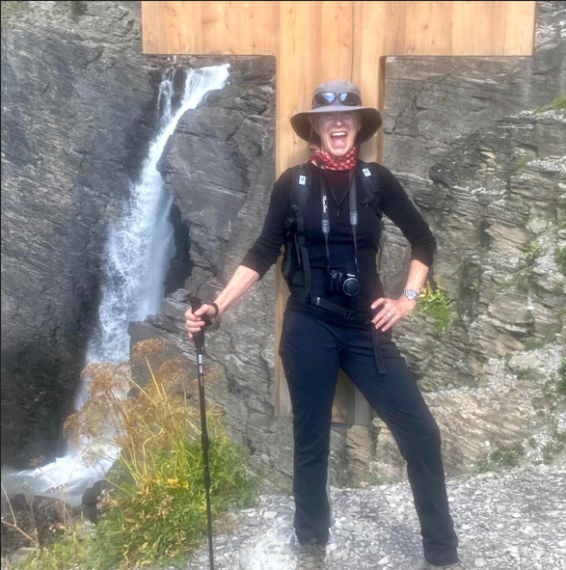
Susan Carman Luyet

Slide 3
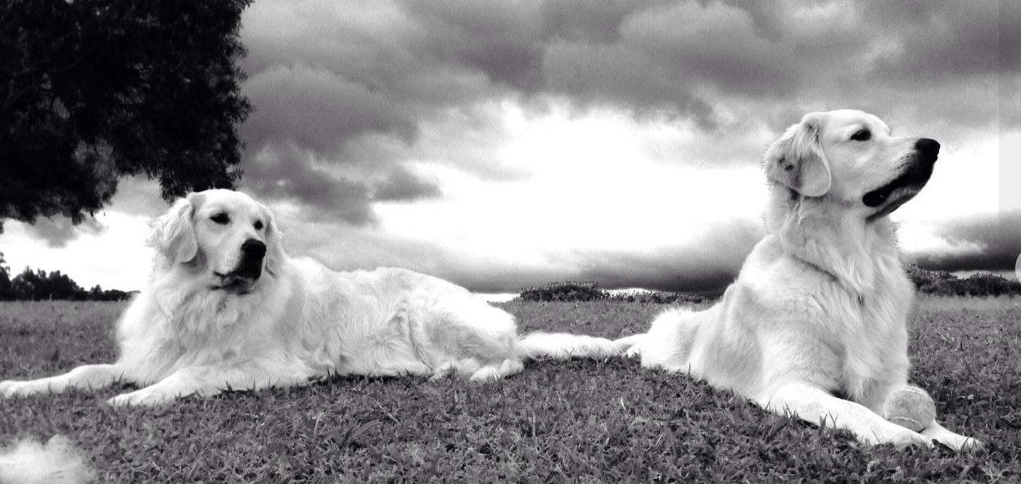
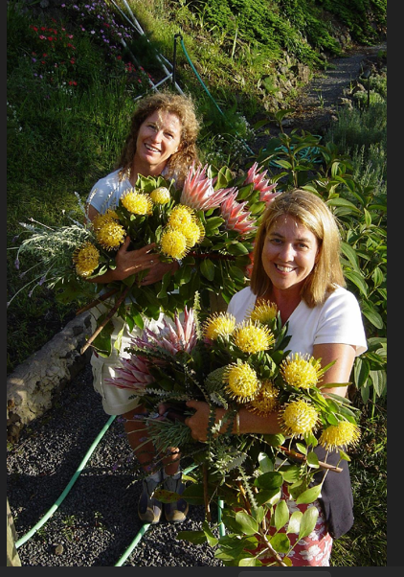
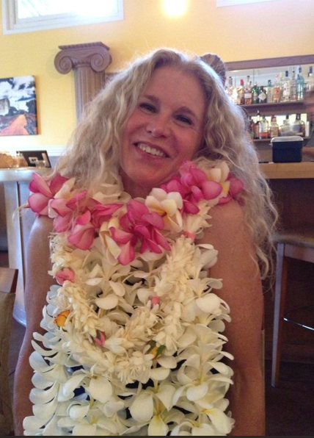
Susan Carman Luyet
Sophie and Bert

