Slide 1
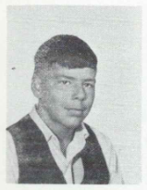
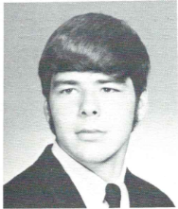
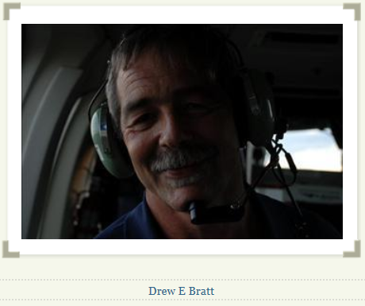
Drew Bratt 1/1/1955 – 10/11/2012
9th Grade
12th Grade

Slide 2
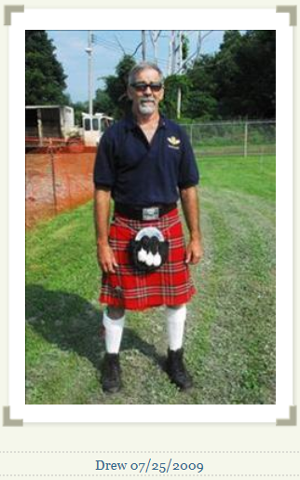
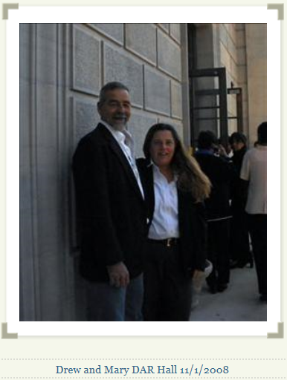
Drew Bratt

Slide 3
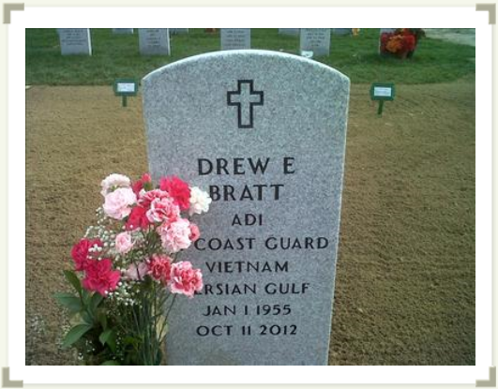
Elihu Bratt, Drew GUILDERLAND Drew Elihu Bratt, 57, of Guilderland, passed away October 11, 2012 at St. Peter's Hospital. He was born on January 1, 1955, son of the late Guy Elihu and Marie (Leininger) Bratt. He married Diane (Pyszkowski) Bratt in 1976. Drew is survived by his three children, Derek Elihu (Sarah) Bratt, David Elihu (Casey Marks) Bratt and Danielle Elizabeth Bratt; two granddaughters, Lindsey and Kylee Bratt; brother, Eric (Joni) Bratt; aunt, Marion Robinson; uncle, Albert (Jiggs) Leininger and numerous nephews, nieces and cousins. As a 1973 graduate of Guilderland Central High School, Drew chose to pursue a career in aviation, and served more than 20 years in the United States Coast Guard. Petty Officer (AD1) Bratt became the recipient of the Distinguished Flying Cross as well as other medals and awards. Upon retiring in 1993, he continued his service with Albany Med. Flight and the New York State Police Aviation Unit. Drew was most proud of his work in search and rescue. He was also a dedicated lifelong member of the Lynnwood Reformed Church. Calling hours will be held on Sunday, October 14 from 5 to 8 p.m. at Fredendall Funeral Home, 199 Main St., Altamont. A funeral service will be held on Monday, October 15, in the funeral home at 10 a.m. Interment will follow at Saratoga National Cemetery. Donations in his memory may be made to the Camp Fowler Scholarship Fund care of Lynwood Reformed Church, 3714 Carman Road, Schenectady, NY 12303.

