Slide 1
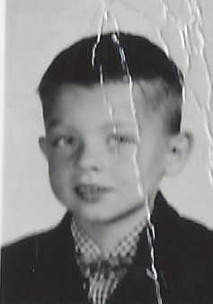
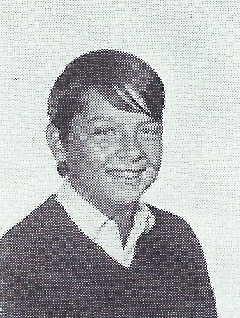
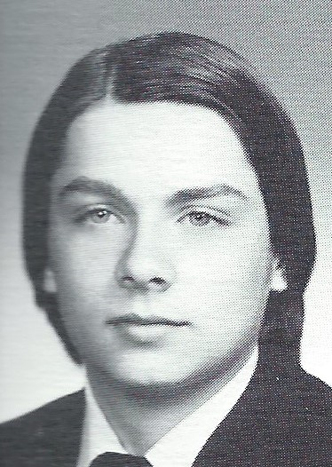
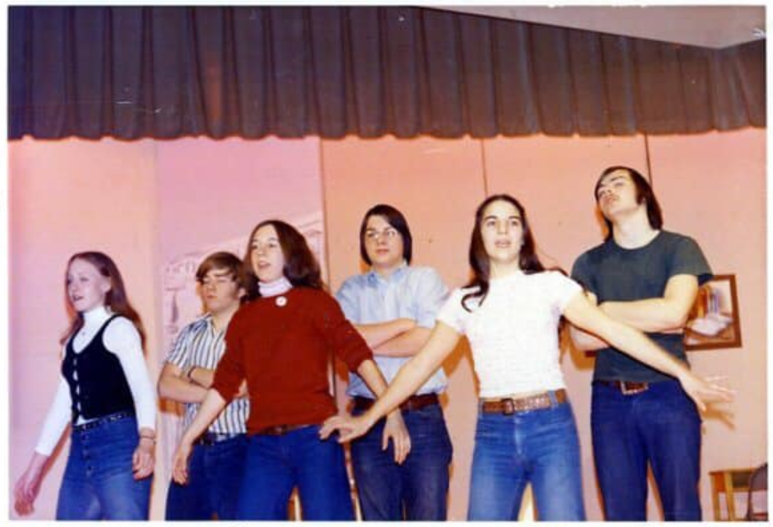
John Carl Bleichner 2/2/1955 - 1/19/2018
Kindergarten
9th Grade
12th Grade
Damn Yankees rehearsal – center back row

Slide 2
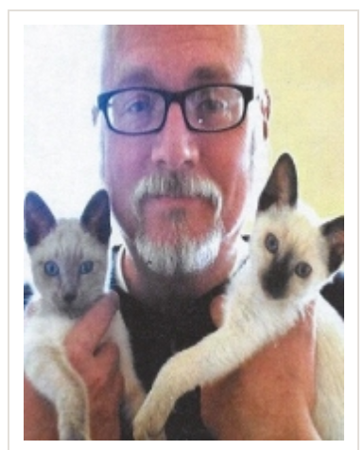
John Carl Bleichner

