Slide 1
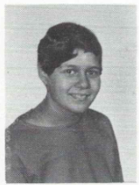
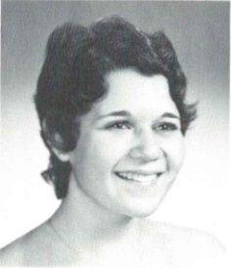
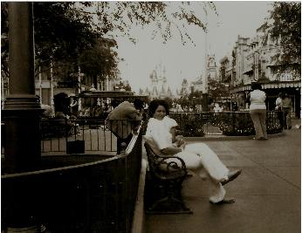
Mary Ellen Bivona (Henzel) 12/31/1954 – 2/13/1985
9th Grade
12th Grade
Magic Kingdom 1974

Slide 2
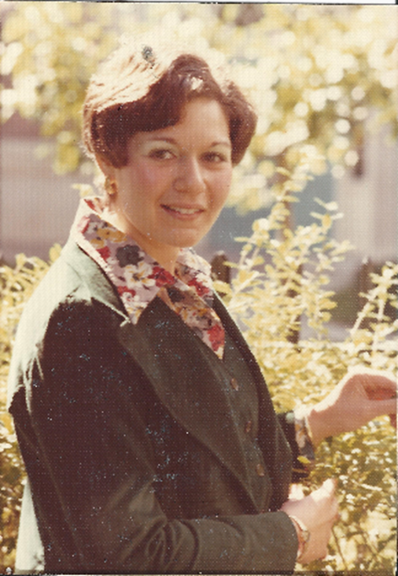
Mary Ellen Bivona (Henzel)

Slide 3
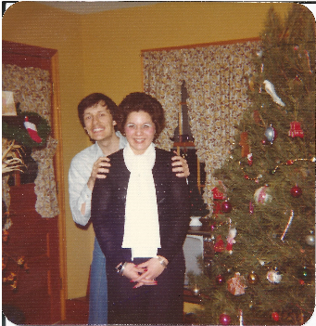
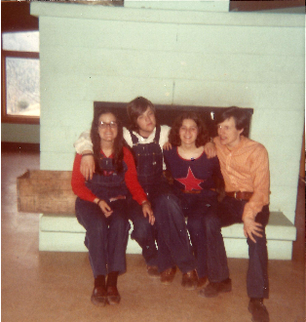
Mary Ellen Bivona (Henzel)
Mary Ellen with Grant Havis
From Left to Right:
Lynn Haas
David Taylor
Mary Ellen Bivona
Grant Havis

Slide 4
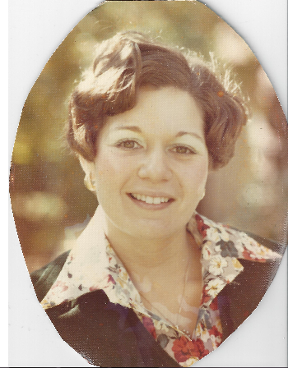
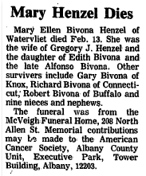
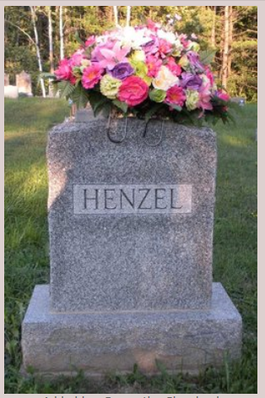
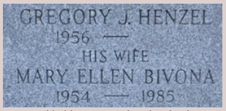
Mary Ellen Bivona (Henzel)

