Slide 1
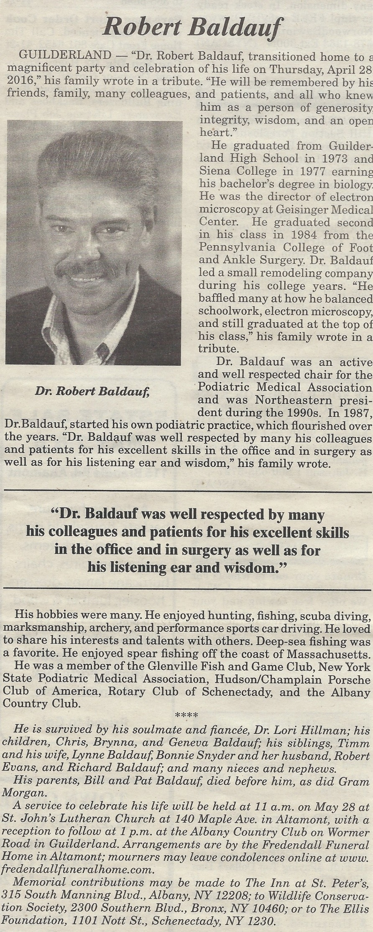
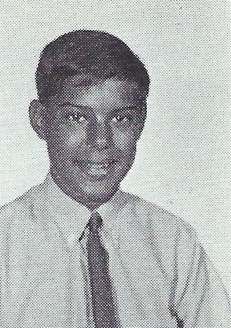
Bob Baldauf 4/28/2016
9th Grade

Slide 2
