Slide 1
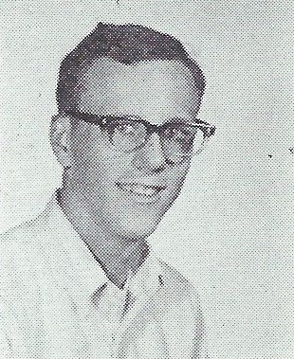
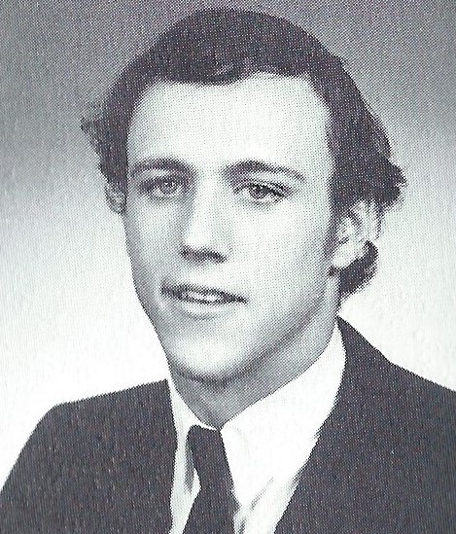
John Adamson 1/20/1955 – 1/24/2014
9th Grade
12th Grade

Slide 2
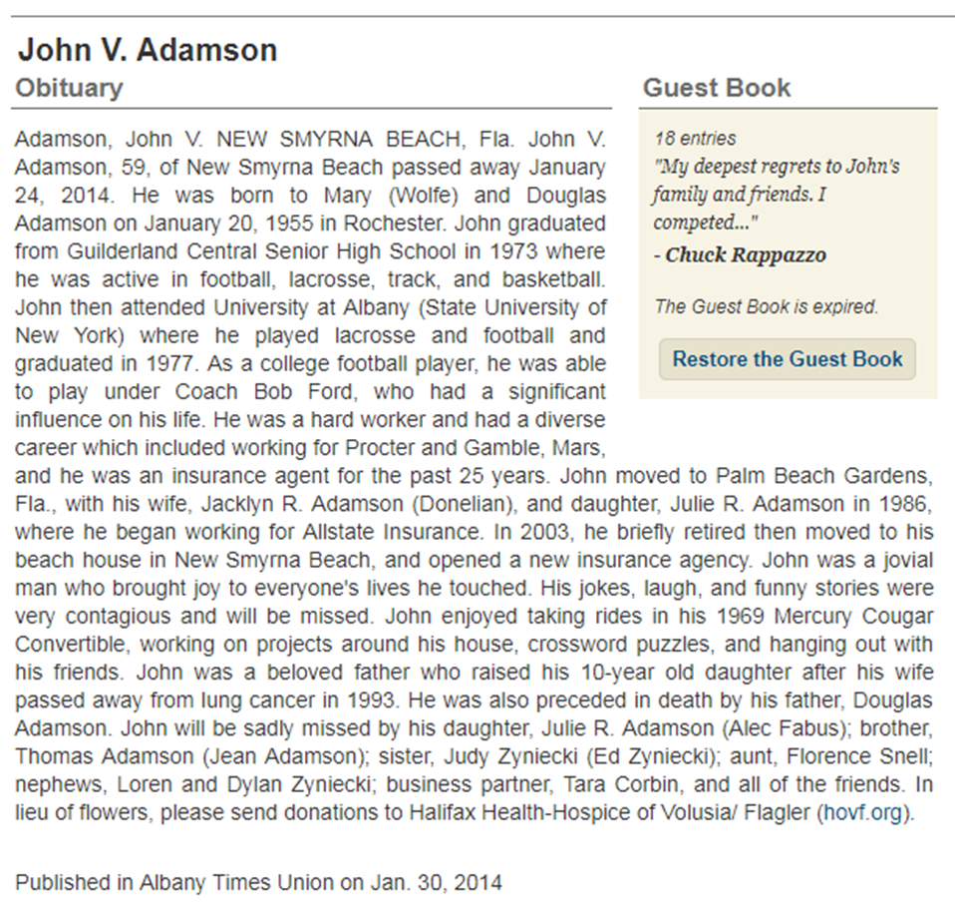
John Adamson

